Slide 1



Inferential Statistics

Slide 2
Agenda
01
05
t-Test
What is Inferential Statistics?
02
Confidence Interval
06
f-test
03
07
z-test
Hypothesis Testing
04
Errors in Hypothesis Testing
08
Chi-Square Test & ANOVA

Slide 3
What is Inferential Statistics?

Slide 4

What is Inferential Statistics?
While descriptive statistics describes the data, inferential statistics is used to draw conclusions about the population based on statistical findings on sample analysis.

Slide 5
Confidence Interval

Slide 6
Confidence Interval
Confidence interval assumes certainty of population parameter falling in the given intervals i.e. 95%, 99%, etc.
For example: If a point estimate 10.0 from the sample statistics for the confidence interval 95% falls into 9.5 to 10.5, we can infer that there is a 95% certainty that the true or population estimate will fall in the same interval.

Slide 7
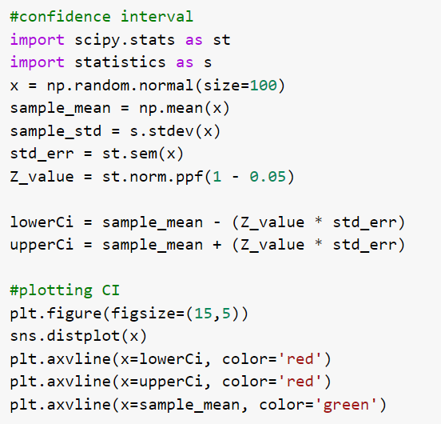
Confidence Interval
We have taken a random normal sample of size 100, and calculated the lower confidence interval and upper confidence interval with interval value 95%.

Slide 8
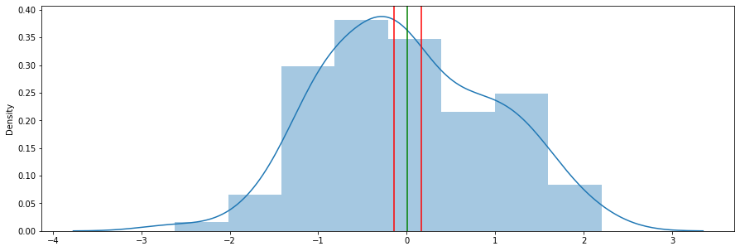
Confidence Interval
According to our analysis, there is 95% certainty that the population will have the mean in the given interval.

Slide 9
Hypothesis Testing

Slide 10

Hypothesis Testing
Hypothesis testing is the analysis where the plausibility of an assumption for a population parameter is tested on the sample, and statistical evidence is used to verify the hypothesis.

Slide 11
Steps involved in Hypothesis Testing
01
Formulate Two Hypothesis for analysis
02
Draw samples from population for analysis
03
Perform appropriate statistical test
04
Accept or reject hypothesis based on evidence

Slide 12
Hypothesis Testing
Null Hypothesis
Alternate Hypothesis
Null Hypothesis states that there is no effect on the population mean.
Alternate Hypothesis states that there is effect on the population mean

Slide 13
Errors in Hypothesis Testing

Slide 14
Errors in Hypothesis Testing
Type 1 Error
Type 2 Error
The Type 1 error is the false positive error where we have rejected the null hypothesis but it is actually true.
Type 2 error is a false negative conclusion where we have not rejected the null hypothesis but it is actually false.

Slide 15
T-Test

Slide 16
T-Test
T-test is a parametric test, that compares the means of the two samples. Ideally, a sample for t-test should have less than 30 values. There are a few other assumptions that are taken before we can conduct a t-test.
Assumptions
1. The samples are independent
2. Homogeneity in sample variances
3. The Data is assumed to be normally distributed.

Slide 17
Types of t-test
One-sample
Two-sample
Paired
If we are comparing the sample against a standard value.
If both the samples are taken from two different populations.
If the samples are taken from the same population.

Slide 18
One-Tailed vs Two-Tailed T-Test
One-tailed
Two-tailed
If we want to check whether the population means are greater than or smaller than, we will use one-tailed test.
If we want to check whether the population means differ significantly, we will use a two tailed test.

Slide 19
One Sample t-test
The average height of Indian adult males is 165cm.
Null hypothesis: The average height is 165cm.
Alternate Hypothesis: The average height is not 165cm.

Slide 20
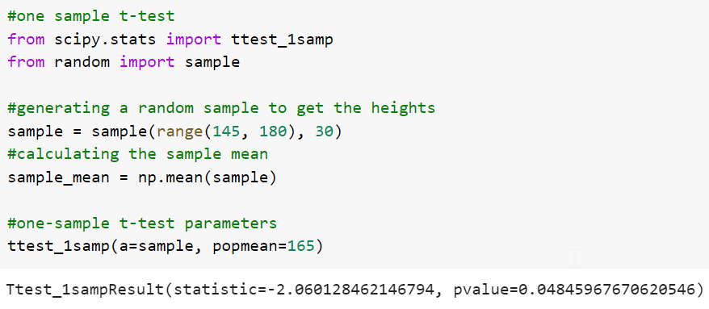
One Sample t-test
We will use python programming to perform a one sample test on a random sample taken from adult Indian males, where each of the 30 samples have their heights in cm.
Since the p-value is less than 0.05, we can reject the null hypothesis.

Slide 21
Two Sample t-test
We have to check whether the mean height of adult males in both the schools is same or not.
Null hypothesis: The means are equal.
Alternate Hypothesis: The means are not equal.

Slide 22
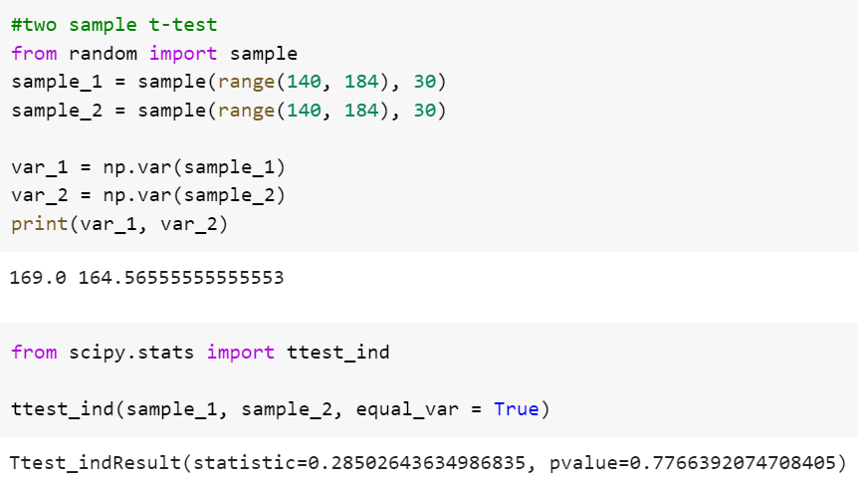
Two-Sample t-test
We will check the variances of each groups and then perform a two-sample t-test for equal variances, otherwise a Welch’s t-test will be conducted by not taking into consideration – the unequal population variances.
We have insufficient evidence to reject the null hypothesis.

Slide 23
Two Sample t-test
We have to check if the mean of heights of males and females are same in the school?
Null hypothesis: The means are equal.
Alternate Hypothesis: The means are not equal.

Slide 24
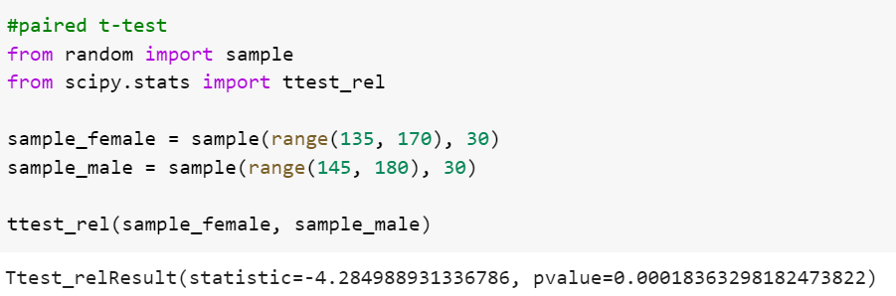
Paired t-test
We will use the paired sample t-test for the groups because the samples come from the same population.
We have sufficient evidence to reject the null hypothesis.

Slide 25
F-Test

Slide 26
F-Test
F-test is a statistical test that is used to compare the variances of two populations. There are several assumptions that are made about the data before we can begin the F-test.
Assumptions
1. Data is normally distributed
2. The data is independent

Slide 27
f-test
We have to check if the variances of the two populations where the groups are taken from equal or not.
Null hypothesis: The variances are equal.
Alternate Hypothesis: The variances are not equal.

Slide 28
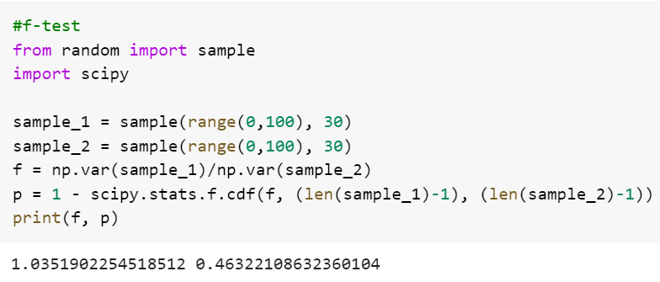
F-test
We will calculate the variances of the two samples and compute the f-statistic and p-value to gather statistical evidence to reject the null hypothesis.
Not enough evidence to reject the null hypothesis.

Slide 29
ANOVA

Slide 30
ANOVA
ANOVA or Analysis of Variance is a statistical test that compares the means or two or more groups to find significance or either groups on one another or how different they are from each other.
Assumptions
1. Independent Samples
2. All populations have common variance
3. Samples are drawn from normally distributed population

Slide 31
One-Way ANOVA
We have to check if the effect of 4 different performance enhancers on an electric vehicle is same or not?
Null hypothesis: The performance averages are equal.
Alternate Hypothesis: The performance averages are not equal.

Slide 32
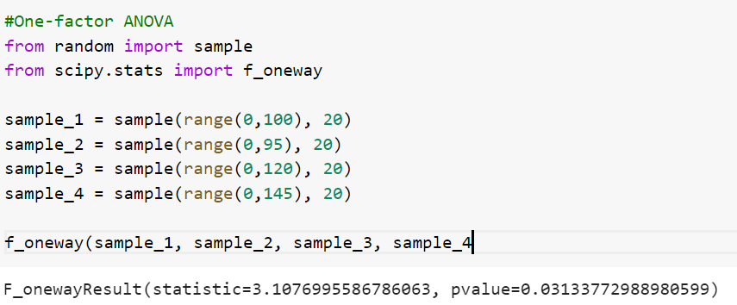
One-Way ANOVA
We have taken 4 random samples that has performance values, we will calculate the test statistics and p-value to reject or fail to reject he null hypothesis.
P-value is less than 0.05, we can reject the null hypothesis.

Slide 33
Two-Way ANOVA
Two way ANOVA checks how two factors will affect the response variable.
Null hypothesis: There is no significance of the two factors on response variable.
Alternate Hypothesis: There is significance of the two factors on response variable.

Slide 34
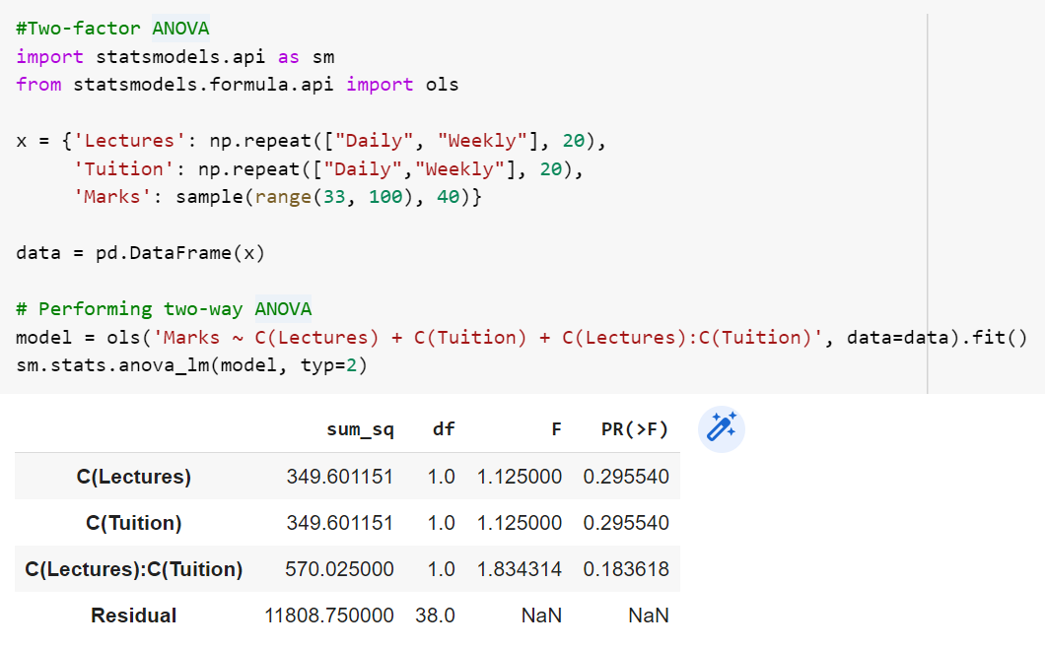
One-Way ANOVA
There is no evidence to reject the null hypothesis.

Slide 35
Z-Test

Slide 36
Z-Test
Z-test is a statistical test to compare the means of populations where the variances are known and sample sizes are considerably larger compared to t-test.
Assumptions
1. Standard Deviation and variances are known.
2. Population should be 10 times as much as the sample size.
3. Samples are drawn at random from the population.

Slide 37
One Sample z-test for Means
The average weight of the high-schoolers pre pandemic was 55Kg with a standard deviation of 8. Has it changed post pandemic?
Null hypothesis: The average weight is same.
Alternate Hypothesis: The average weight is not same.

Slide 38
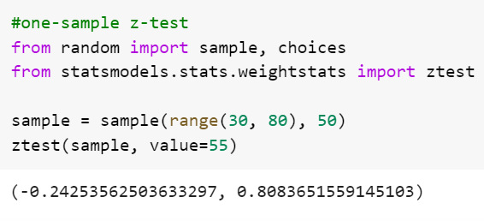
One Sample z-test for Means
We will use a one sample z-test for this problem, where we will take weights of 50 high schoolers randomly and perform the z-test using python.
Not enough evidence to reject the null hyptohesis

Slide 39
Two Sample z-test for Means
Is the average height post pandemic for high schoolers going to school A and school B is same, given that the standard deviation of the populations is known.
Null hypothesis: The mean difference is zero.
Alternate Hypothesis: The mean difference is not zero.

Slide 40
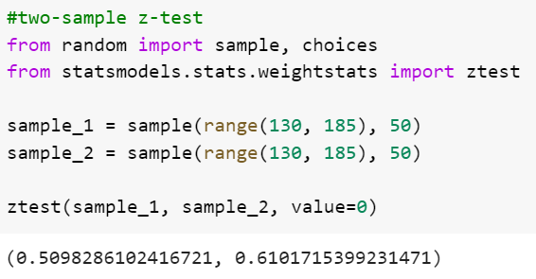
Two Sample z-test for Means
We will take one sample from each of the populations with 50 individuals each. And then perform a two-sample z-test using python.
Not enough evidence to reject the null hypothesis

Slide 41
One Sample z-test for Proportion
It was observed from a purchase case study, that 35% of women spend more than 10000. Is it true for our population in analysis?
Null hypothesis: The proportion is same.
Alternate Hypothesis: The proportion is not same.

Slide 42
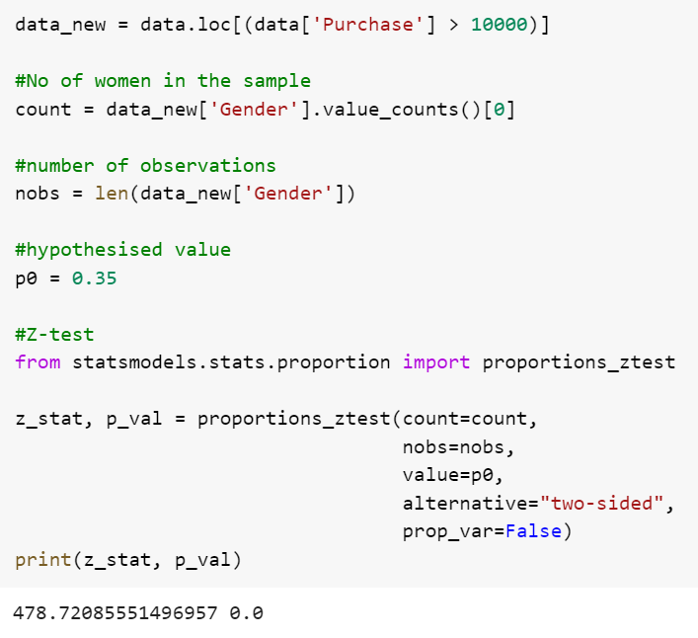
One Sample z-test for Proportion
We will perform a one sample z-test for proportion to check the test statistics in order to reject or fail to reject the null hypothesis. Since the p-value is less than 0.05, we can reject the null hypothesis.

Slide 43
Two Sample z-test for Proportion
Is the percentage of men who have spend more than 10000 same for the ages 18-25 and 26-35
Null hypothesis: The proportion is same.
Alternate Hypothesis: The proportion is not same.

Slide 44
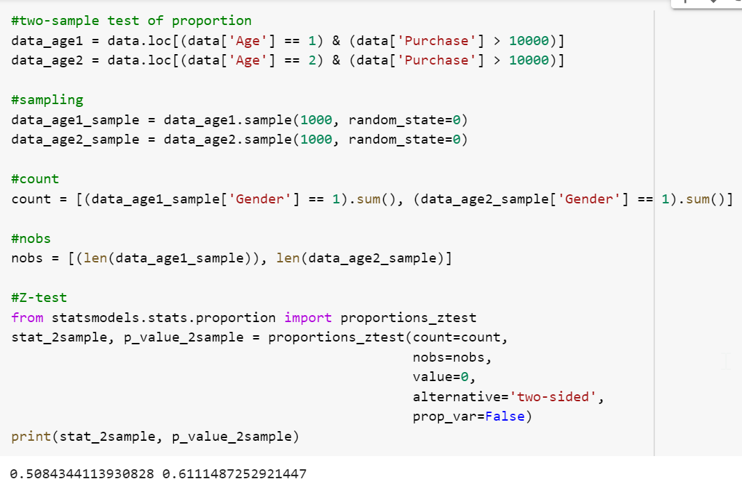
z-test for Proportion
We will perform a two sample z-test for proportion to check the test statistics in order to reject or fail to reject the null hypothesis. Not sufficient evidence to reject the null hypothesis.

Slide 45
Chi-Square Test

Slide 46
Chi-Square Test
Chi-Square test for categorical data that can be used to check the goodness of fit or test of independence.
Assumptions
1. The features are categorical in Nature
2. The samples are taken at random.
3. Minimum of five observations expected in each group.

Slide 47
Chi-Square Test of Independence
Is Purchase independent of Product_Category_1?
Null hypothesis: Purchase and product_category_1 are not related
Alternate Hypothesis: Purchase and product_category_1 are related

Slide 48
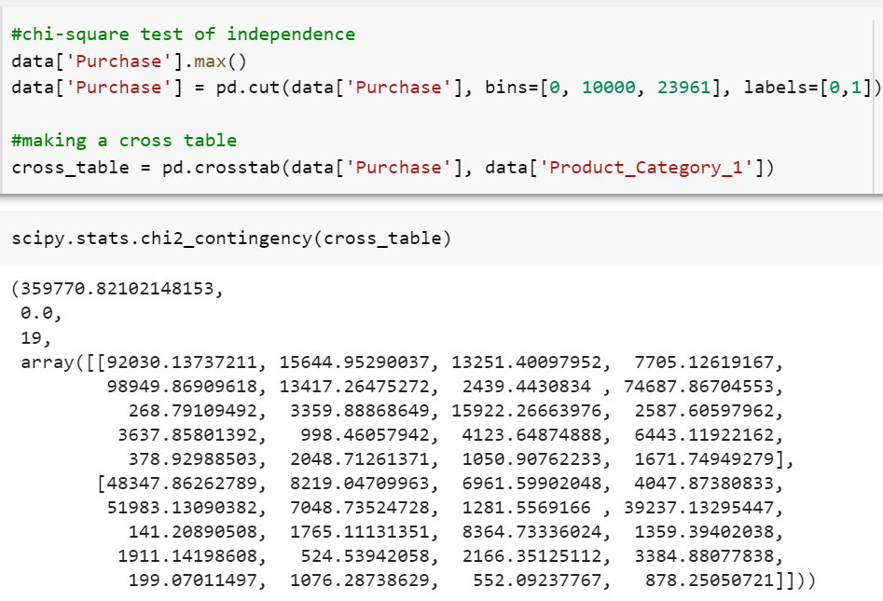
Chi-Square Test of Independence
We will perform chi-square test of independence and validate our assumptions based on statistical evidence. P-value is less than 0.05, we can reject the null hypothesis.

Slide 49

India: +91-7847955955
US: 1-800-216-8930 (TOLL FREE)
support@intellipaat.com
24/7 Chat with Our Course Advisor
Notes:
Thank you!

